Slide 1
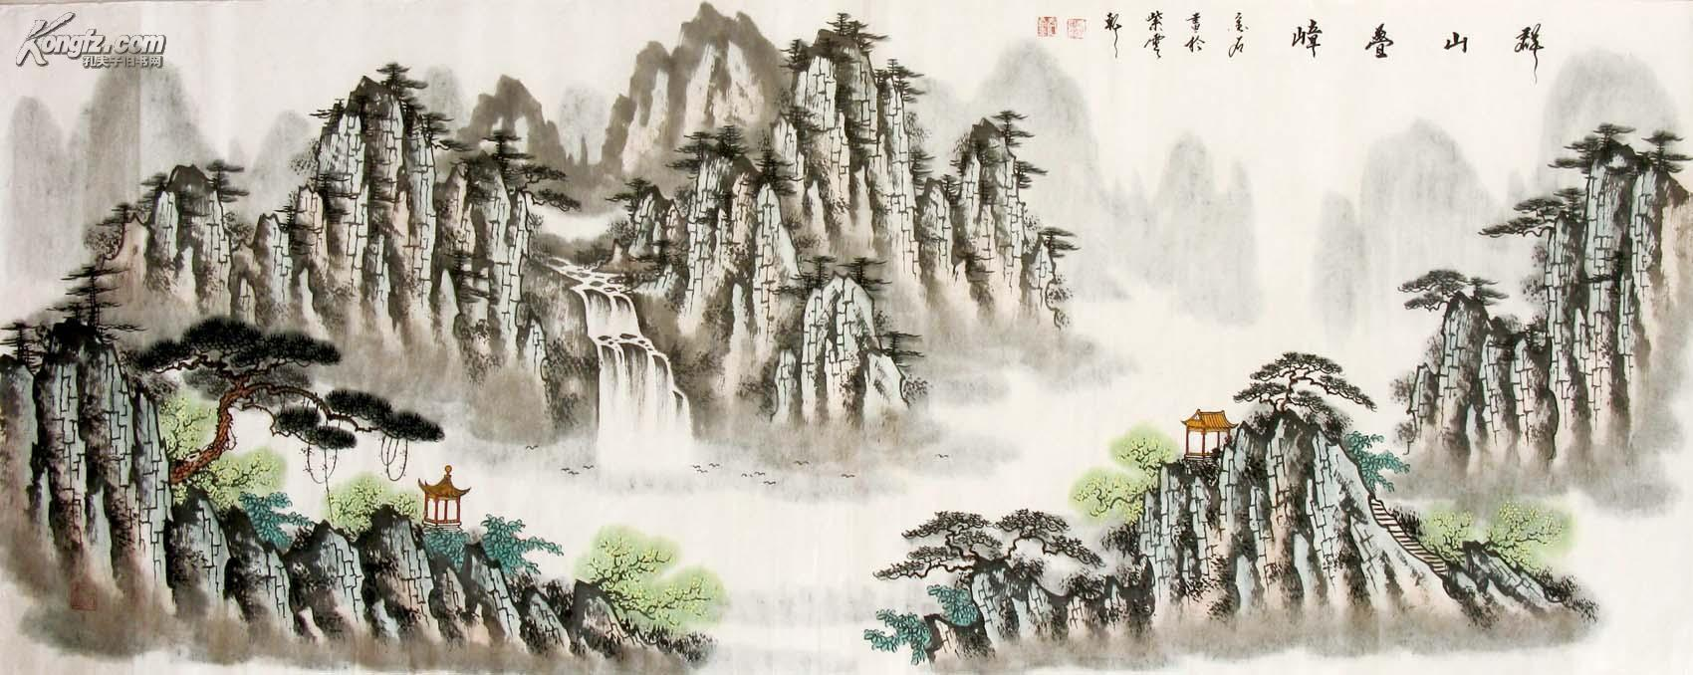
Chinese Culture
Team :Night Knight
Leader: Dumbledore
Member: Sven
Jay

Slide 2

index
The four arts
Festivals and food
Four Great Inventions
Chinese Clothes
Webpage screenshot

Slide 3
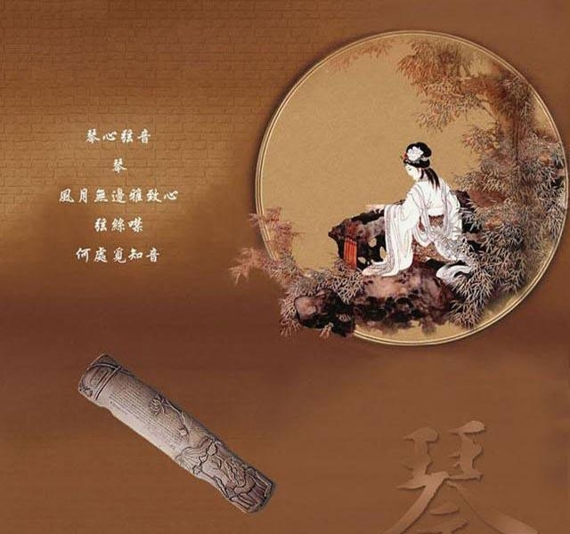
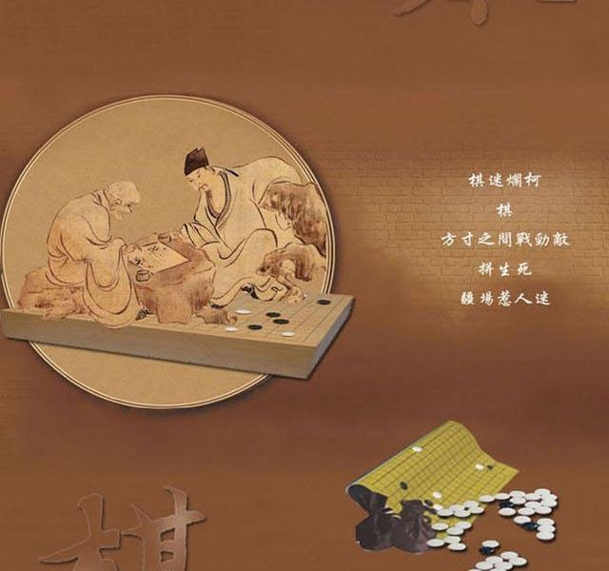
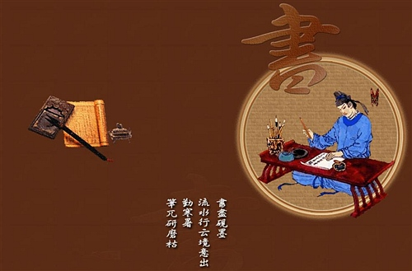
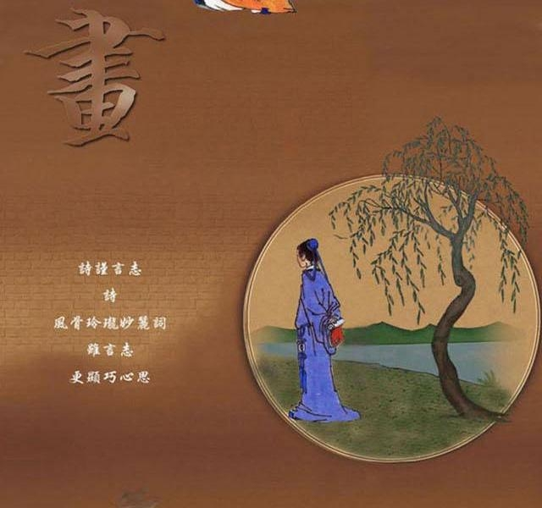
The four arts
The four arts, or the four arts of the Chinese scholar were the four main academic and artistic accomplishments required of the aristocratic ancient chinese scholar-gentleman caste. They They are JEAN, CHESS, CALLIGRAPHY and PAINTING.

Slide 4
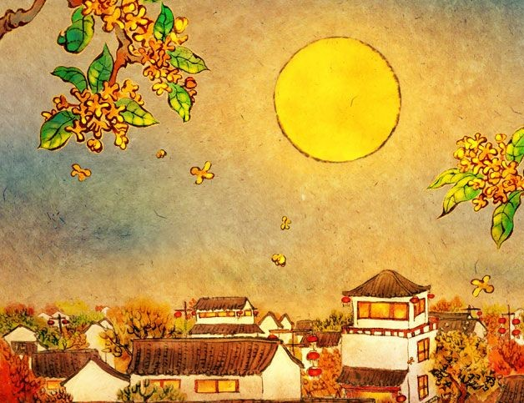
Festivals and food
Traditional holiday meals are different from everyday meals in terms of quantity and quality. In addition, some foods with a long history and symbolic significance are indispensable on these occasions.
For example, The Mid-autumn Festival is an occasion for viewing the full moon. The round moon is a symbol for completeness, and family reunion. The special food of the day is the yuebing, a round moon cake.

Slide 5
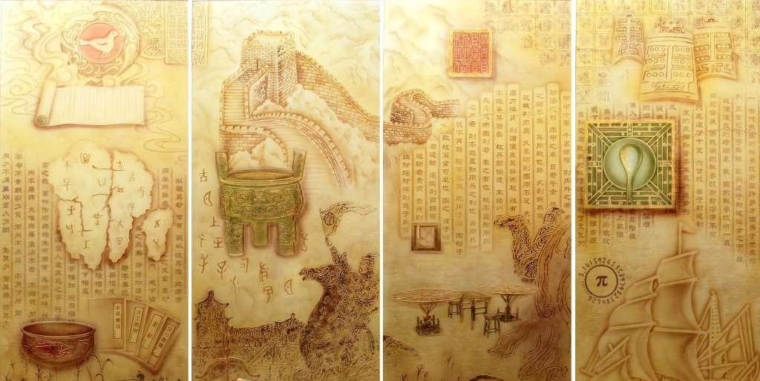
Four Great Inventions
Papermaking, gunpowder, printing and the compass are four ancient inventions by Chinese people that have had a huge impact on the entire world.
The invention of paper greatly contributed to the spread and development of civilization. Before its invention, bones, tortoise shells, and bamboo slips were all used as writing surfaces, but as Chinese civilization developed they proved themselves unsuitable because of their bulk and weight. Hemp fiber and silk were used to make paper but the quality was far from satisfactory. Besides, these two materials could be better used for other purposes so it was not practical to make paper from them.
Xue fu wu che is a Chinese idiom describing a learned man. The story behind it concerns a scholar named Hui Shi who lived during the Warring States Period. He needed five carts to carry his books when he traveled around teaching. Books at that time were made of wood or bamboo slips so they were heavy and occupied a lot of space. Reading at the time needed not only brainwork but also physical strength.
In 105 A.D. Cai Lun, a eunuch during the Eastern Han Dynasty, invented paper from worn fishnet, bark and cloth. These raw materials could be easily found at a much lower cost so large quantities of paper could be produced.
The making technique was exported to Korea in 384 A.D. A Korean Monk then took this skill with him to Japan in 610 A.D.
During a war between the Tang Dynasty and the Arab Empire, the Arabs captured some Tang soldiers and paper making workers. Thus, a paper factory was set up by the Arabs.
In the 11th Century the skill was carried to India when Chinese monks journeyed there in search of Buddhist sutras.
Through the Arabs, Africans and Europeans then mastered the skill. The first paper factory in Europe was set up in Spain. In the latter half of the 16th century, this skill was brought to America. By the 19th century, when paper factories were set up in Australia, paper making had spread to the whole world.

Slide 6
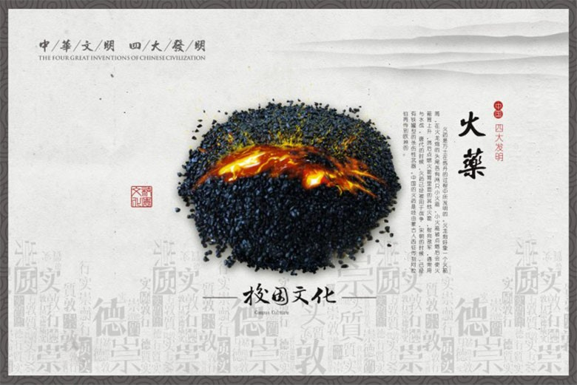
Gunpowder
In Chinese, gunpowder is called huo yao, meaning flaming medicine. Unlike paper and printing, the birth of gunpowder was quite accidental. It was first invented inadvertently by alchemists while attempting to make an elixir of immorality. It was a mixture of sulphur, saltpeter, and charcoal. At the end of the Tang Dynasty, gunpowder was being used in military affairs. During the Song and Yuan Dynasties, frequent wars spurred the development of cannons, and fire-arrows shot from bamboo tubes.
In the 12th and 13th centuries, gunpowder spread to the Arab countries, then Greece, other European countries, and finally all over the world.

Slide 7
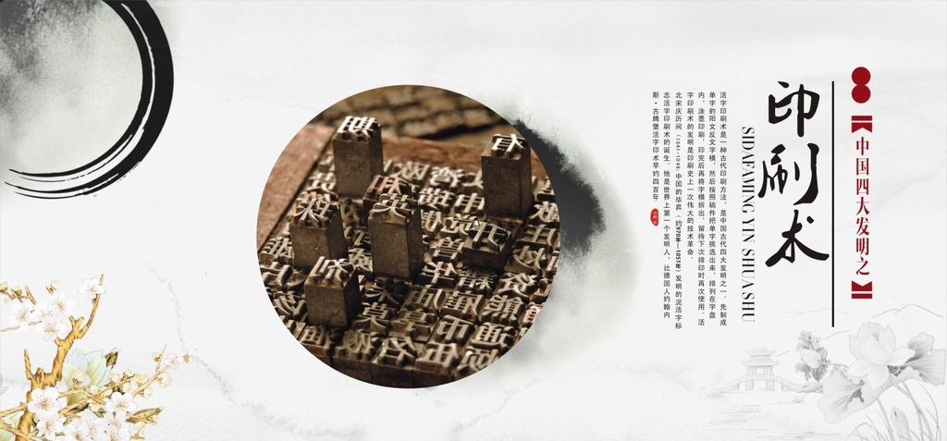
Printing Technique
During the reign of Emperor Ren Zong of the Northern Song Dynasty, Bi Sheng invented moveable, reusable clay type after numerous tests. Single types were made and picked out for printing certain books. These types could be used again and again for different books. Because of the large number of different characters in the Chinese written language, this technique did not have a dramatic impact at the time. However, today, this typesetting technique is regarded as a revolution in the industry. About 200 years later, this moveable-type technique spread to other countries and advanced the development of world civilization.

Slide 8
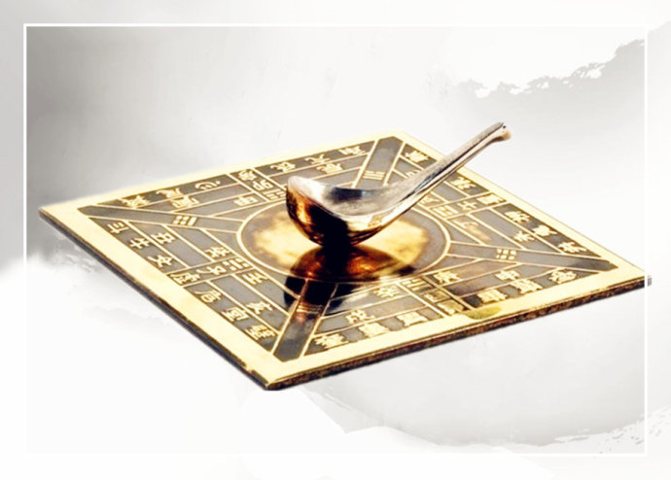
Compass
During the Warring States period, a device called a Si Nan became the forerunner of the compass. A Si Nan was a ladle-like magnet on a plate with the handle of the ladle pointing to the south. In the 11th century, tiny needles made of magnetized steel were invented. One end of the needle points north while the other points south. The compass was thus created. The compass greatly improved a ship's ability to navigate over long distances. It was not until the beginning of the 14th century that compass was introduced to Europe from China.

Slide 9

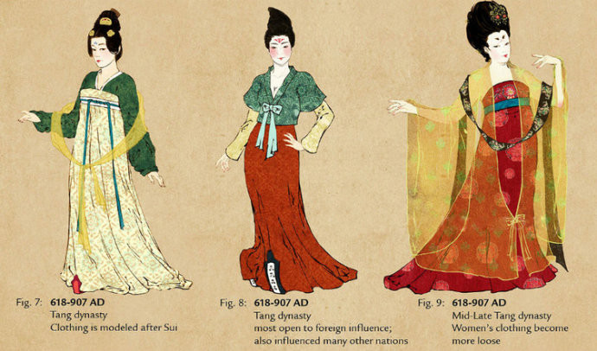
Hanfu, a national formal wear, takes its name from the times of the Han Dynasty, and now long out of fashion. A complete set of Hanfu, covers the clothing, clothing accessories, jewelry etc, and reflects the rituals of Chinese culture from that era.
In recent years, there has been a revival of traditional Chinese attires. Some young people engaged in promoting Hanfu through the Internet social networking. On traditional Chinese festivals such as Tomb Sweeping Day and Mid-autumn Festival and formal occasions, the younger people put on their Hanfu. Once, on top of Xian City Wall, more than one hundred couples got married in a ceremony according to ancient edicts wearing Han Chinese garb.
Chinese Clothes

Slide 10
Thanks for Wathcing

